Slide 1

Team 6
Mirela Curiman, Karim Abdel Ghany, Jessica Mai

Slide 2
The Product
An artificial intelligence developed for analyzing website's content in respect of SEO and improving the ranking

Slide 3
The problem we Solve
SEO is time consuming and costly

Slide 4
How has it been Solved in the Past
Use SEO analysis tools and implement your findings
Or
Hire a SEO agency

Slide 5
How much do Companies Charge for SEO
Hourly Business Model
50% of SEO‘s charge 75$ - 200$/Hour
88% charge 150$/Hour or less
Only 6.25% charge more than 200$

Slide 6
Put it to figures - Hourly
0
75$
150$
200$
43.75%
44.25%
5.75%
6.25%

Slide 7
How much do Companies Charge for SEO
Monthly Business Model
45% of SEO‘s charge 501$ - 2000$/Month
75.77% charge 2000$/Month or less
24.23% charge more than 2000$

Slide 8
Put it to figures - Monthly
0
500$
2000$
30.77%
45%
24.23%

Slide 9
How much do Companies Charge for SEO
Per Project
52.32% charge 1000$ or more
69.54% charge 2000$ or less
30.46% charge more than 2000$

Slide 10
Put it to figures – per project
0
1000$
2000$
47.68%
21.86%
30.46%

Slide 11
SEO Business models
40.8% have multiple pricing models
Majority (59.2%) has only 1 pricing model
39.66% overall only charge monthly
74.71% use monthly pricing as one or all of their pricing models

Slide 12
Take aways
Monthly charge is the most common pricing model
SEO agencies charge more than consultants and freelancers
More experienced SEO‘s charge sagnificantly more
So are they doing for worldwide market compared to local markets

Slide 13
How many Companies do spend on SEO
Only 44% of Businesses are investing in SEO

Slide 14
Why so few?
SEO
does not have instant gratification
You do not see the impact of work right away
Is hard to meause
needs time
Only 22% of pages that rank top 10 were created within a year

Slide 15
Is seo still a market for us?
Yes
We solve the instant gratification problem by creating more transperency (KPI‘s) and charging the customer only for ranking improvement
Time is not a resource customers have to worry about anymore since our AI does the job
Even if only 44% of businesses spend on SEO, it‘s still a huge market!!!

Slide 16
Who is our customer?
Who needs SEO?
Primarily (Who needs SEO the most?)
Small businesses and stratups
SaaS & online service companies
Niche companies
Locally exclusive companies
Medical/Legal/Maintenance Professionals
Restaurants & Bars
Secondarily (Who else needs SEO?)
Everyone else, who owns a website (make the whole web a better place)

Slide 17
Are they really our Customers?
Yes, as these figures show

Slide 18
How important is seo?
Average SEO Importance Score
77/100

Slide 19
Top Reasons for not using seo
Not enough budget
Not enough time
Not enough knowledge
Not transperent (not sure if it is worth it, not sure if it pays off)

Slide 20
AI Concerns

Slide 21
Top Reasons to consider the Use of SEO
Cheaper (86,96%)
Less Time Consuming (67,39%)
Things that need to be improved
Transparency
Less effort

Slide 22
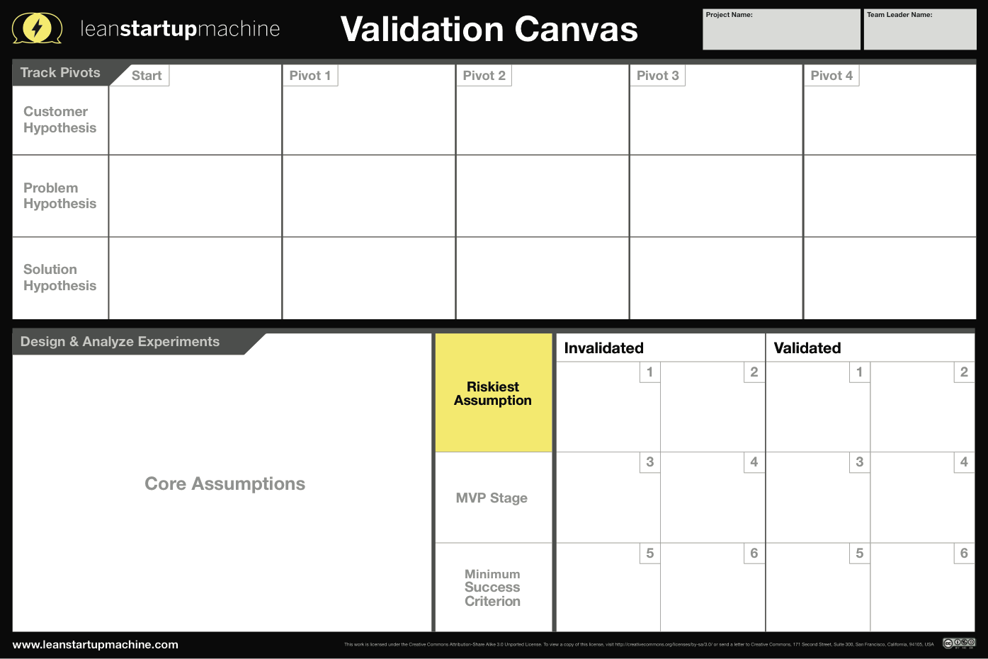
Everyone who owns a website
SEO is too expensive and time consuming, also requires a lot of know-how
AI that analyzes webpages in terms of SEO and provides embeddable code or files
People do not trust AI and fear Data abuse
People do not trust AI
People find SEO too expensive
People find SEO too time consuming
People find SEO not transparent enough
People are willing to pay 100€ for our service
We got 17 Users in 1 hour
Landing page to see wheather people would use the service
15 in 1 hour

Slide 23
Everyone who owns a website
Primary Customer Selection
SEO is too expensive and time consuming, also requires a lot of know-how
SEO is too time consuming
AI that analyzes webpages in terms of SEO and provides embeddable code or files
AI that analyzes webpages in terms of SEO and provides embeddable code or files
People want SEO to be less time consuming
People do not trust AI
People find SEO too expensive
People find SEO too time consuming
People find SEO not transparent enough
People are willing to pay 100€ for our service
60% stated
People do not fear AI
Cold Calls
At least 70% state so

Slide 24
Everyone who owns a website
Primary Customer Selection
Primary Customer Selection
SEO is too expensive and time consuming, also requires a lot of know-how
SEO is too time consuming
SEO is too expensive
AI that analyzes webpages in terms of SEO and provides embeddable code or files
AI that analyzes webpages in terms of SEO and provides embeddable code or files
AI that does SEO and costs amount of ranking improvement
People want SEO to be less expensive
People do not trust AI
People find SEO too expensive
People find SEO too time consuming
People find SEO not transparent enough
People are willing to pay 100€ for our service
Not all people find SEO too time consuming
People do not fear AI
86% stated -
People want SEO to be less expensive
Survey
At least 70% state so

Slide 25
Team 6
Mirela Curiman, Karim Abdel Ghany, Jessica Mai

Slide 26
What‘s next?
Now that we know we‘re facing a real problem, we need to
find a niche in the market
check if the niche is still profitable

Slide 27
What is our niche market?
Narrowed down our Primary Customer Selection
Small businesses and stratups
SaaS & online service companies
Niche companies
Locally exclusive companies
Medical/Legal/Maintenance Professionals
Restaurants & Bars

Slide 28
What is our niche market?
Narrowed down our Primary Customer Selection
Small businesses and stratups – that do not yet invest in SEO

Slide 29
Why this niche?
In this niche, companies
take the most effect, when investing in SEO
have the highest need for a cheap service
easily contrast with their competitors
will be most profitable to us, considering our business model

Slide 30
Is there still a Market in our Niche?
Yes, as these figures show

Slide 31
Top Reasons Company isn‘t investing in SEO
Too small of a budget
Too expensive
Missing knowledge
Not enough employees
Too time consuming

Slide 32
What is the maximum Amount your Company Could Spend on SEO in a month?
The average amount of money that could possibly be spent on SEO is 827€/Month.

Slide 33
Everyone who owns a website
Primary Customer Selection
Primary Customer Selection
SEO is too expensive and time consuming, also requires a lot of know-how
SEO is too time consuming
SEO is too expensive
AI that analyzes webpages in terms of SEO and provides embeddable code or files
AI that analyzes webpages in terms of SEO and provides embeddable code or files
AI that does SEO and costs amount of ranking improvement
People want SEO to be less expensive
People do not trust AI
People find SEO too expensive
People find SEO too time consuming
People find SEO not transparent enough
People are willing to pay 100€ for our service
Not all people find SEO too time consuming
People do not fear AI
86% stated -
People want SEO to be less expensive
Survey
At least 70% state so

Slide 34
Everyone who owns a website
Primary Customer Selection
Primary Customer Selection
Local Businesses and Startups that do not use SEO
SEO is too expensive and time consuming, also requires a lot of know-how
SEO is too time consuming
SEO is too expensive
Small companies do not have enough budget for SEO
AI that analyzes webpages in terms of SEO and provides embeddable code or files
AI that analyzes webpages in terms of SEO and provides embeddable code or files
AI that does SEO and costs amount of ranking improvement
AI that does SEO and costs amount of ranking improvement
Local Businesses/Startups are willing to spend their small budget for SEO
People do not trust AI
People find SEO too expensive
People find SEO too time consuming
People find SEO not transparent enough
People are willing to pay 100€ for our service
Not all people find SEO too time consuming
People do not fear AI
86% stated -
People want SEO to be less expensive
Survey
Is the niche market still profitable
Who are our early adopters
92% are willing to provide budget
33% of survey responses state they are willing to provide a SEO budget

Slide 35
What is our ideal early Adopter?

Slide 36
Everyone who owns a website
Primary Customer Selection
Primary Customer Selection
Local Businesses and Startups that do not use SEO
SEO is too expensive and time consuming, also requires a lot of know-how
SEO is too time consuming
SEO is too expensive
Small companies do not have enough budget for SEO
AI that analyzes webpages in terms of SEO and provides embeddable code or files
AI that analyzes webpages in terms of SEO and provides embeddable code or files
AI that does SEO and costs amount of ranking improvement
AI that does SEO and costs amount of ranking improvement
Local Businesses/Startups are willing to spend their small budget for SEO
People do not trust AI
People find SEO too expensive
People find SEO too time consuming
People find SEO not transparent enough
People are willing to pay 100€ for our service
Not all people find SEO too time consuming
People do not fear AI
86% stated -
People want SEO to be less expensive
1. Define ideal early adopter - Persona
2. Survey – find early adopters
Find at least 10 early adopters

Slide 37
SMArt Goals
Name | Team Goal | Individual Goal
Jessica | More onsite instead of remote teamwork (at least two meetings every week) | Present and discuss in English (at least once a week each)
Mirela | Time management (keep track of deadlines for our group and remind members) | Extend Business Network (2 contacts every Week)
Karim | Facilitation (make complex processes and terms easier understandable) | Sharpen analytical skills (Analyze at least once a week, e.g. Google Analytics, marketing figures etc.)

Slide 38
NeXt Week
Extend landing page (Wizard of Oz) – Track button to see if early adopters are willing to pay / to share (Thank you page and share buttons for social media)
Lean Canvas

Slide 39
Team 6
Mirela Curiman, Karim Abdel Ghany, Jessica Mai

Slide 40
The Product
An artificial intelligence developed for analyzing website's content in respect of SEO and improving the ranking

Slide 41
The problem we Solve
SEO is time consuming and costly

Slide 42
Which Hypothesis did we have?

Slide 43
Hypothesis
Invalidated
People find SEO too time consuming
Validated
People do not fear AI
People want SEO to be less expensive
Even small budget/low revenue companies are willing to privde budget for a good service
Besides Core Assumptions
People do not use SEO because they have a lack of knowledge
People find SEO not transparent enough

Slide 44
Which Experiments did we Run?

Slide 45

Experiments
Vanity
Customer Interviews
Business Model Canvas
Enlightning
Surveys
Landing Page
Cold calls/emails
Persona
A ton of research
Under construction
Wizard of Oz
Customer Journey Map
ARRR

Slide 46
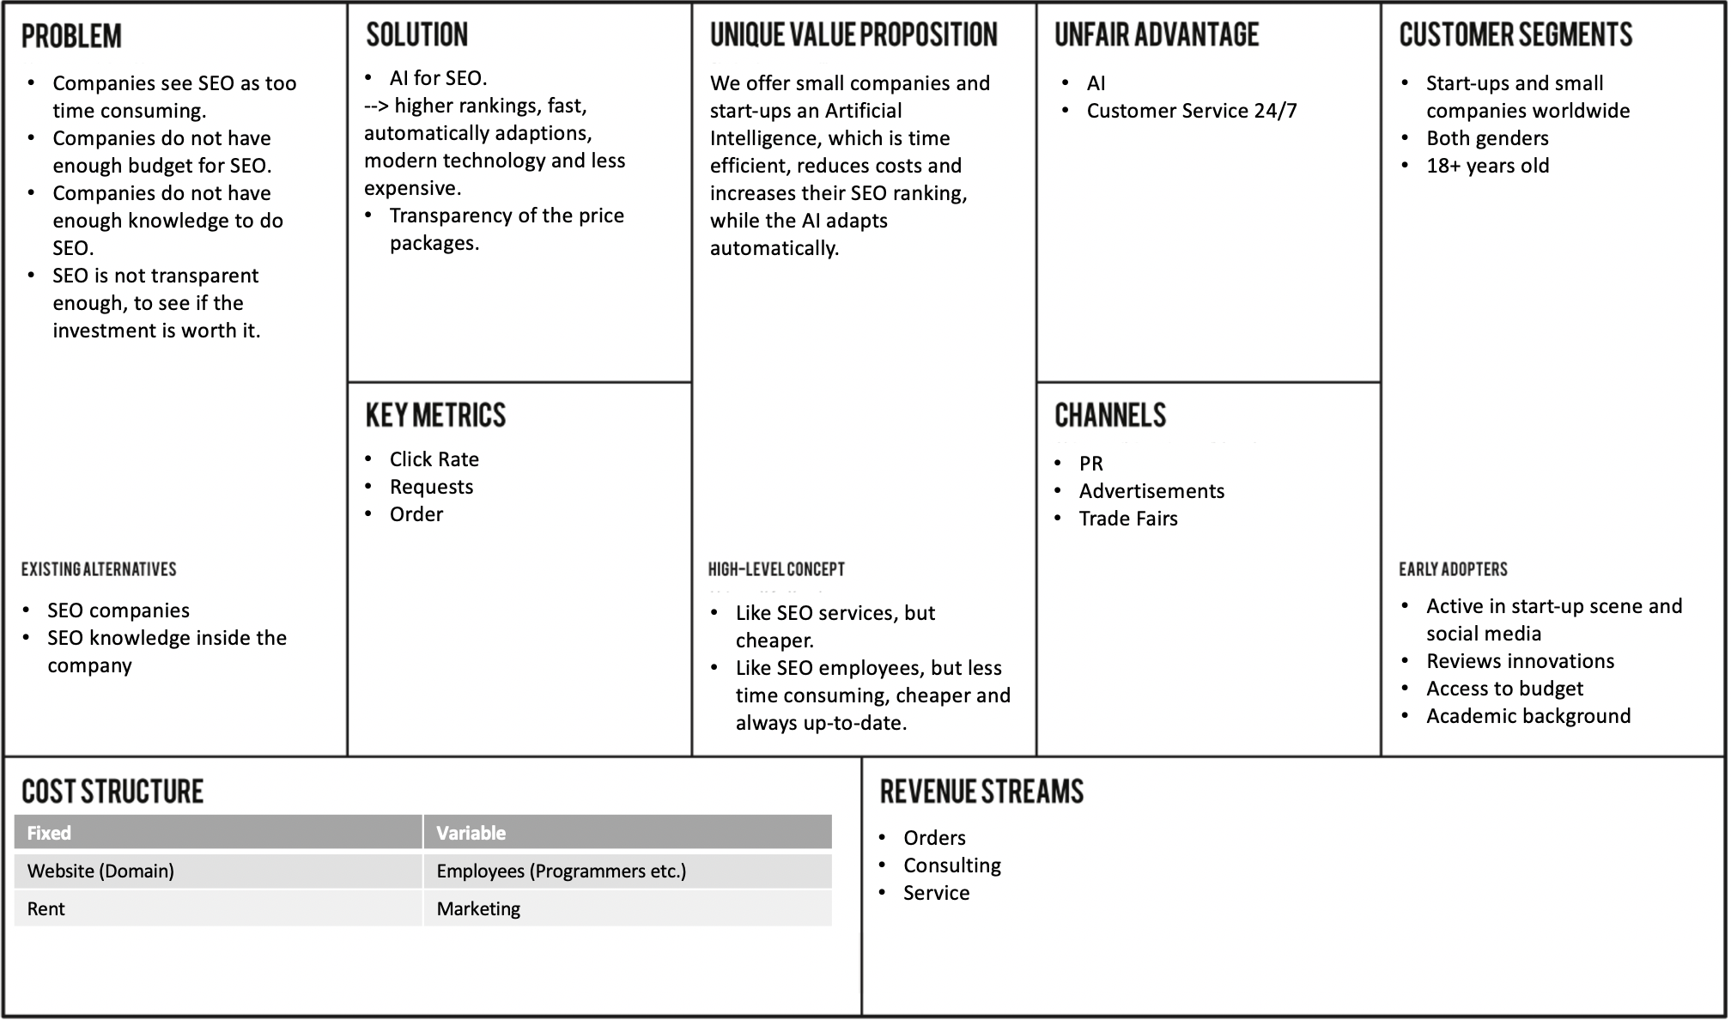
Lean canvas

Slide 47
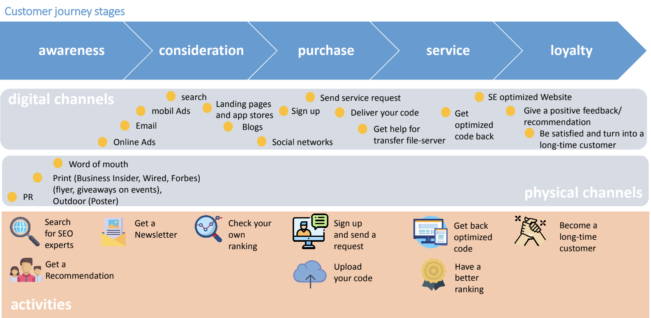
Customer journey map

Slide 48
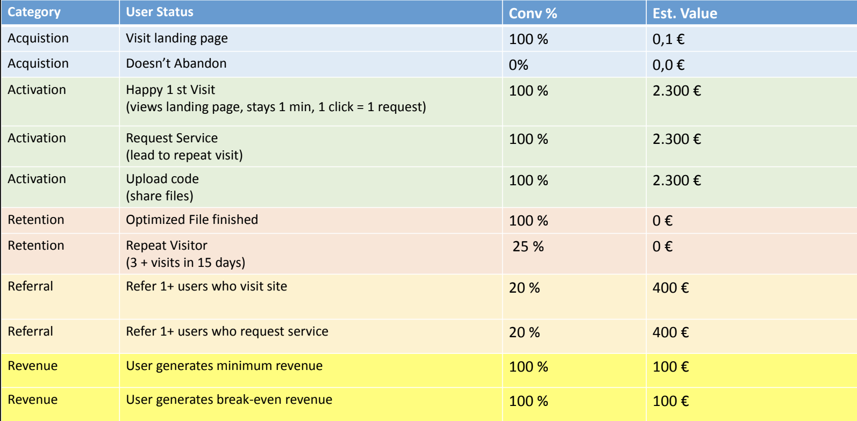
AARRR

Slide 49
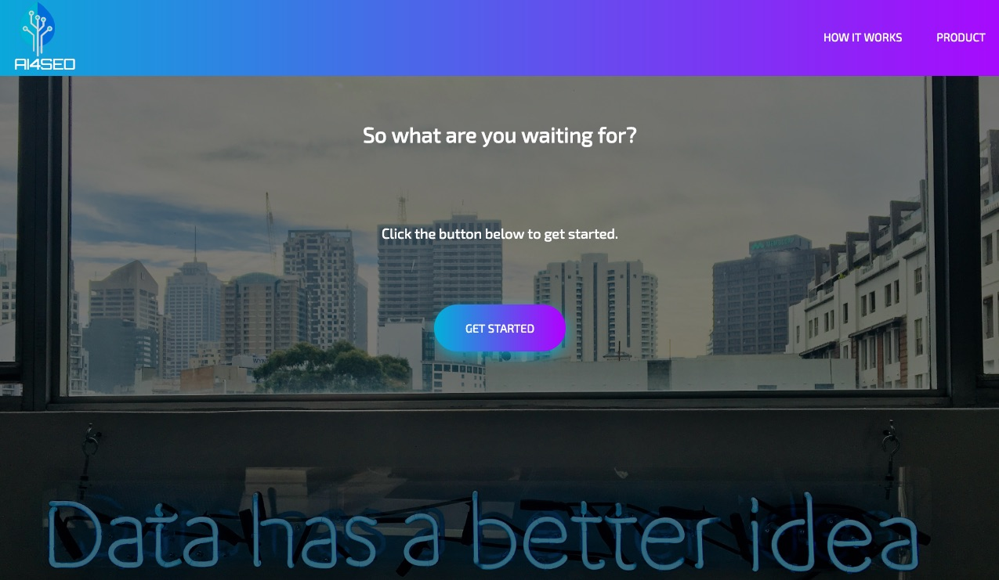
Landing Page

Slide 50
Survey 1
47 Participants
Do you know what SEO is? – Yes
Do you think SEO is important? –Yes
Do you already use SEO? Yes / Not yet, but considering it
If you don't use SEO, why? No budget, too time consuming, no knowledge
How much do you pay for SEO per month? (If you selected"No", please skip this question) - approx. 1,550€
Do you know what AI is? – Yes
Would you trust Artificial Intelligence regarding SEO? – Yes / I would consider it.
Would you prefer to pay less and provide your company's data to an AI? – Yes / I would consider it.
Under which circumstances would you like to use / pay for SEO? – Cheaper / Less time consuming
If you already use SEO, how would you imagine a better service? – Improved and higher ranking, faster & adapting.

Slide 51
Survey 2
18 Participants – Early Adopters
Why is your company not investing into SEO? – No Budget / Time.
If SEO was less expensive, would it be possible to approve budget for it? 94% Yes
If it increases your revenue, what is the maximum acceptable budget your company could spend on SEO in a month?
Which position do you own in your company?
Are you responsible for any kind of budget management in your company?
What is your highest level of education? – Master, Doctor, Bachelor
Which Social Media Channels do you use? – LinkedIn, Facebook, Instagram,
Reddit, Twitter.
How frequently do you generate content on social media? Weekly
How many followers do you have on your most viewed social media account? – More than 3,000
What was the highest amount of reactions you received on a post so far? – Over 3,000

Slide 52
Directly contacting
Small businesses and startups
SaaS & online service companies
Niche companies
Locally exclusive companies
Medical/Legal/Maintenance Professionals
Restaurants & Bars
→ 61 companies by mail / phone

Slide 53
Directly contacting
26 Startups:
Memematch /Appgrade
Steuerbot
Ahead
Oddity
Moovel
Regiohelden
Smapone
Pioniergeist
Acmeo
Peat Infarm, Berlin
Auto1Group, Berlin
door2door, Berlin
Contentful, Berlin
Spryker, Berlin
FlixMobility, Munich
Comatch, Berlin
Horizn Studios, Berlin
Celonis, München
N26, Berlin
Yerka Bikes, Chile
Haize
Noa, Silicon Valley
Cobi
Eyeo GmbH
Heartbeat

Slide 54
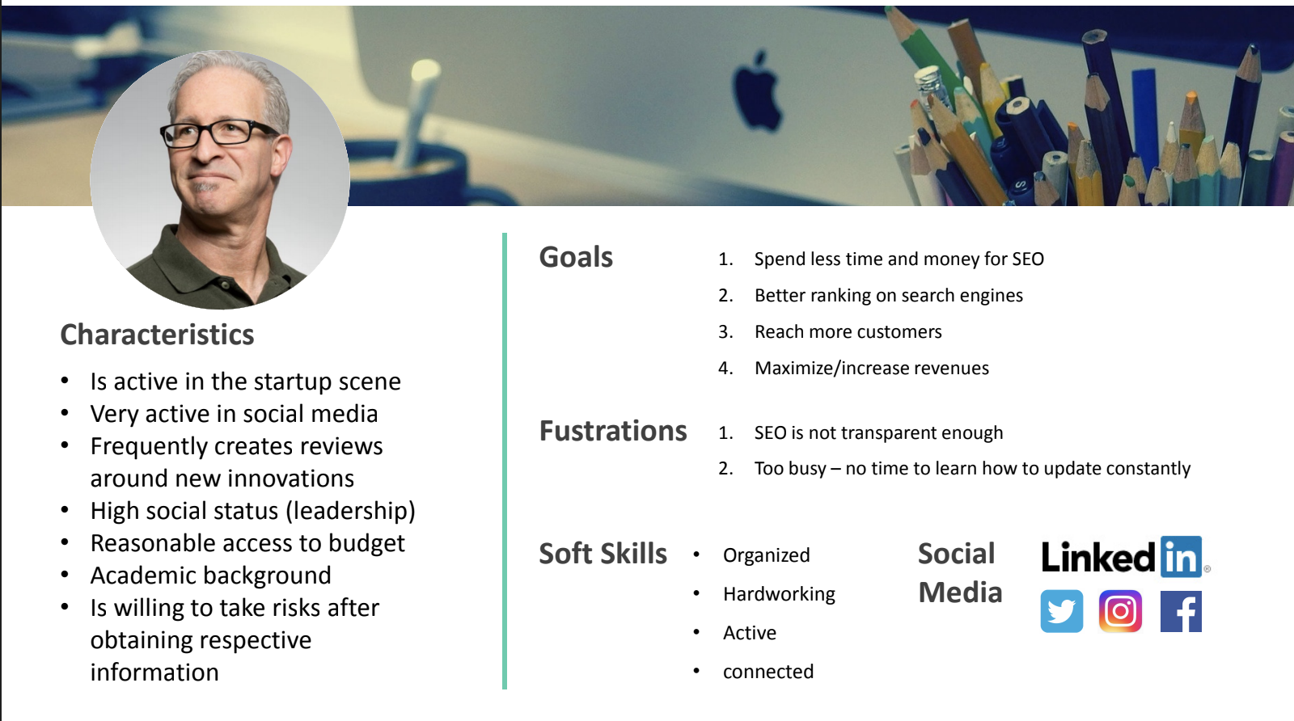
Persona

Slide 55
Research
Wanna see my Report real quick?

Slide 56
What did we learn from it?

Slide 57
Learnings
It‘s useful to make mistakes
Vanity metrics won‘t get you any further
Rather take more time and run a well-prepared experiments that you can learn from, than pickung up the pace just to deliver anything for a deadline
To get good metrics a lot of research has to be done in advance
You can learn a lot from other peoples mistakes, too

Slide 58
What did Our Pivots Look like?

Slide 59
Pivots
From: Too time consuming & lack of know-how
To: Just too time consuming
To: Too expensive
To: Too expensive for small companies

Slide 60
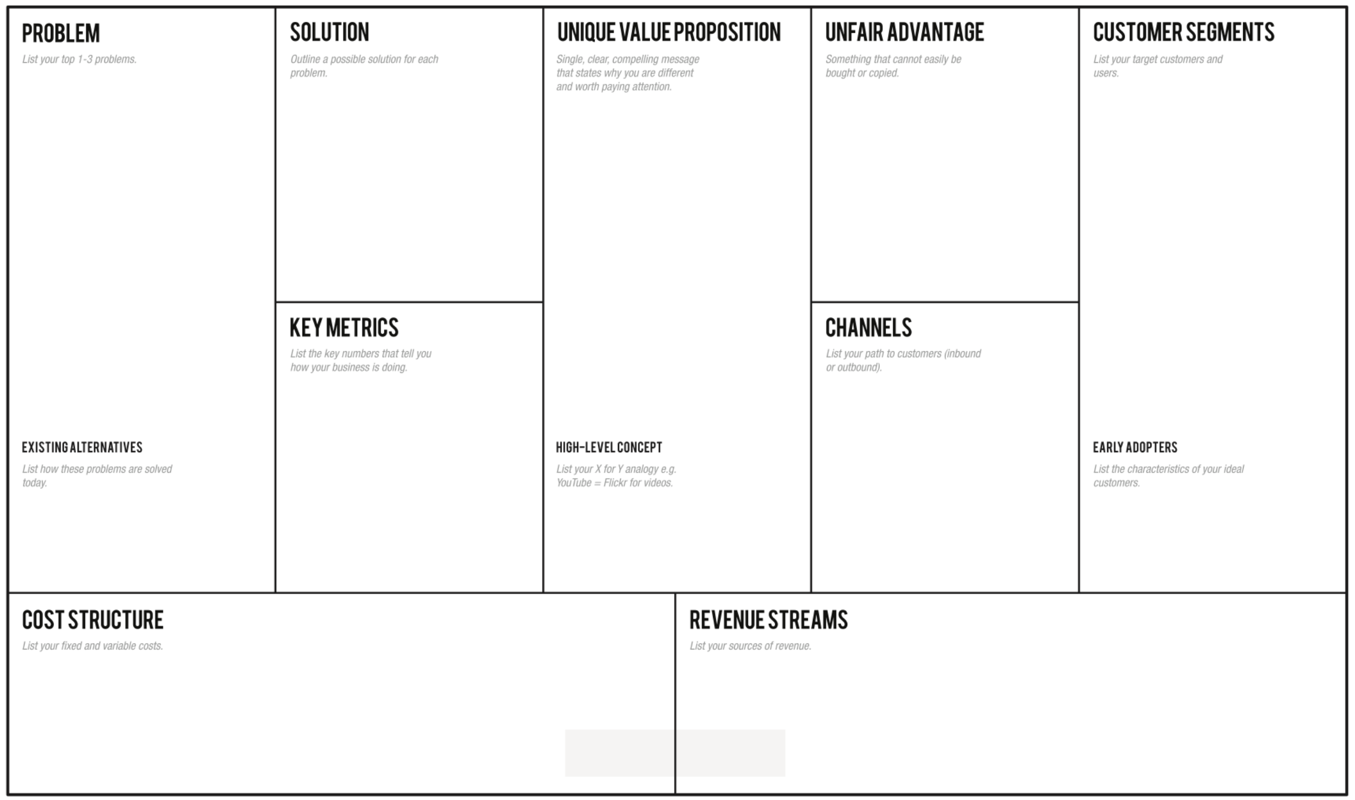
Affordable subscription for the use of an AI doing SEO instad of hiring
Consume ranking APIs
AI analyzes and generates code within seconds
Technical Knowledge
Pricing algorithm
Business network
Startups & Small Companies
Locally Exclusive Companies
SaaS and Online Companies
(Everyone who owns a website)
SEO is not affordable enough
SEO is not transparent enough
SEO is too time consuming
AI adapts
Time efficient
Reduces costs
Creates transparency
Pay per Improvement
Attention
Enrolement/Conversion
Revenue per Customer
Website
Social Media
Mobile App
Usage of other marketing channels e.g. Social Media
Like image conversion, but with non-SE-optimized to SE-optimized files
Website
Social Media
Mobile App
Subscriptions
Consulting
Addon Features
Domain
Programmers of AI
Customer Service
Servers

Slide 61
What Influence did this have on our lean Canvas?

Slide 62
Everyone who owns a website
SEO is too expensive and time consuming, also requires a lot of know-how
AI that analyzes webpages in terms of SEO and provides embeddable code or files
People do not trust AI and fear Data abuse
People do not trust AI
People find SEO too expensive
People find SEO too time consuming
People find SEO not transparent enough
People are willing to pay 100€ for our service
We got 17 Users in 1 hour
Landing page to see wheather people would use the service
15 in 1 hour

Slide 63
Everyone who owns a website
Primary Customer Selection
SEO is too expensive and time consuming, also requires a lot of know-how
SEO is too time consuming
AI that analyzes webpages in terms of SEO and provides embeddable code or files
AI that analyzes webpages in terms of SEO and provides embeddable code or files
People want SEO to be less time consuming
People do not trust AI
People find SEO too expensive
People find SEO too time consuming
People find SEO not transparent enough
People are willing to pay 100€ for our service
60% stated
People do not fear AI
Cold Calls
At least 70% state so

Slide 64
Everyone who owns a website
Primary Customer Selection
Primary Customer Selection
SEO is too expensive and time consuming, also requires a lot of know-how
SEO is too time consuming
SEO is too expensive
AI that analyzes webpages in terms of SEO and provides embeddable code or files
AI that analyzes webpages in terms of SEO and provides embeddable code or files
AI that does SEO and costs amount of ranking improvement
People want SEO to be less expensive
People do not trust AI
People find SEO too expensive
People find SEO too time consuming
People find SEO not transparent enough
People are willing to pay 100€ for our service
Not all people find SEO too time consuming
People do not fear AI
86% stated -
People want SEO to be less expensive
Survey
At least 70% state so

Slide 65
Everyone who owns a website
Primary Customer Selection
Primary Customer Selection
Local Businesses and Startups that do not use SEO
SEO is too expensive and time consuming, also requires a lot of know-how
SEO is too time consuming
SEO is too expensive
Small companies do not have enough budget for SEO
AI that analyzes webpages in terms of SEO and provides embeddable code or files
AI that analyzes webpages in terms of SEO and provides embeddable code or files
AI that does SEO and costs amount of ranking improvement
AI that does SEO and costs amount of ranking improvement
Local Businesses/Startups are willing to spend their small budget for SEO
People do not trust AI
People find SEO too expensive
People find SEO too time consuming
People find SEO not transparent enough
People are willing to pay 100€ for our service
Not all people find SEO too time consuming
People do not fear AI
86% stated -
People want SEO to be less expensive
Survey
92% are willing to provide budget
33% of survey responses state they are willing to provide a SEO budget

Slide 66
WhICh hypothesis did we validate and how?

Slide 67
Team 6
Mirela Curiman, Karim Abdel Ghany, Jessica Mai

Slide 68
Persona

Slide 69
Are we able to find early adopters?
Yes, as these figures show

Slide 70
Social media Channels
Top 3 social media channels:
LinkedIn (93.75%)
Twitter (87.50%)
Facebook (81.25%)
100% of the survey participants use at least 2 social media channels!

Slide 71
Social Media Influence

Slide 72
Everyone who owns a website
Primary Customer Selection
Primary Customer Selection
Local Businesses and Startups that do not use SEO
SEO is too expensive and time consuming, also requires a lot of know-how
SEO is too time consuming
SEO is too expensive
Small companies do not have enough budget for SEO
AI that analyzes webpages in terms of SEO and provides embeddable code or files
AI that analyzes webpages in terms of SEO and provides embeddable code or files
AI that does SEO and costs amount of ranking improvement
AI that does SEO and costs amount of ranking improvement
Local Businesses/Startups are willing to spend their small budget for SEO
People do not trust AI
People find SEO too expensive
People find SEO too time consuming
People find SEO not transparent enough
People are willing to pay 100€ for our service
Not all people find SEO too time consuming
People do not fear AI
86% stated -
People want SEO to be less expensive
Survey
92% are willing to provide budget
33% of survey responses state they are willing to provide a SEO budget

Slide 73
Everyone who owns a website
Primary Customer Selection
Primary Customer Selection
Local Businesses and Startups that do not use SEO
SEO is too expensive and time consuming, also requires a lot of know-how
SEO is too time consuming
SEO is too expensive
Small companies do not have enough budget for SEO
AI that analyzes webpages in terms of SEO and provides embeddable code or files
AI that analyzes webpages in terms of SEO and provides embeddable code or files
AI that does SEO and costs amount of ranking improvement
AI that does SEO and costs amount of ranking improvement
We are able to find early adopters for our startup idea
People do not trust AI
People find SEO too expensive
People find SEO too time consuming
People find SEO not transparent enough
People are willing to pay 100€ for our service
Not all people find SEO too time consuming
People do not fear AI
86% stated -
People want SEO to be less expensive
Survey
92% are willing to provide budget
We found 5 early adopters
We can find at least 5 early adopters

Slide 74
Our early adopters are
MemeMatch

